Slide 1
Support Vector Machine II

Slide 2
Support Vector Machine
Cost function
Large margin classification
Kernels
Using an SVM

Slide 3

















Support vector machine
$$\min_{θ} C\left[\sum_{i=1}^{m}{y^{(i)} cost_{1}\left(θ^{⊤}x^{\left(i\right)}\right)+(1−y^{\left(i\right)}\text{)} cost_{0}\left(θ^{⊤}x^{\left(i\right)}\right)}\right]+\sum_{j=1}^{n}{θ_{j}^{2}}$$
If “y = 1”, we want $θ^{⊤}x≥ 1$ ($not just ≥0)$
If “y = 0”, we want${ θ}^{⊤}x≤−1$ ($not just <0)$
$$cost_{1}\left(θ^{⊤}x\right)$$
$$cost_{0}\left(θ^{⊤}x\right)$$
$$if y=1$$
$$if y=0$$
$$−2$$
$$−1$$
$$0$$
$$1$$
$$2$$
$$θ^{⊤}x$$
$$−2$$
$$−1$$
$$0$$
$$1$$
$$2$$
$$θ^{⊤}x$$

Slide 4
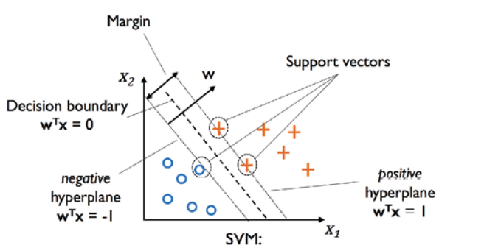
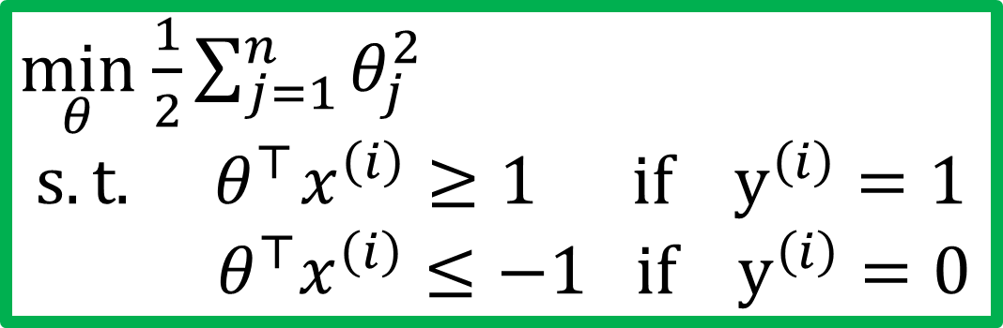


SVM decision boundary
$$\min_{θ} C\left[\sum_{i=1}^{m}{y^{(i)} cost_{1}\left(θ^{⊤}x^{\left(i\right)}\right)+(1−y^{\left(i\right)}\text{)} cost_{0}\left(θ^{⊤}x^{\left(i\right)}\right)}\right]+\frac{1}{2}\sum_{j=1}^{n}{θ_{j}^{2}}$$
Let’s say we have a very large $C…$
Whenever $y^{\left(i\right)}=1:$
$θ^{⊤}x^{\left(i\right)}≥1$
Whenever $y^{\left(i\right)}=0:$
$θ^{⊤}x^{\left(i\right)}≤−1$
$\min_{θ}$ $\frac{1}{2}\sum_{j=1}^{n}{θ_{j}^{2}}$ $$s.t.{ θ}^{⊤}x^{\left(i\right)}≥1 if y^{\left(i\right)}=1$$
$${ θ}^{⊤}x^{\left(i\right)}≤−1 if y^{\left(i\right)}=0$$

Slide 5


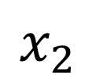


SVM decision boundary: Linearly separable case
$$x_{2}$$
$$x_{1}$$

Slide 6


SVM decision boundary: Linearly separable case
$$x_{2}$$
margin
$$x_{1}$$

Slide 7
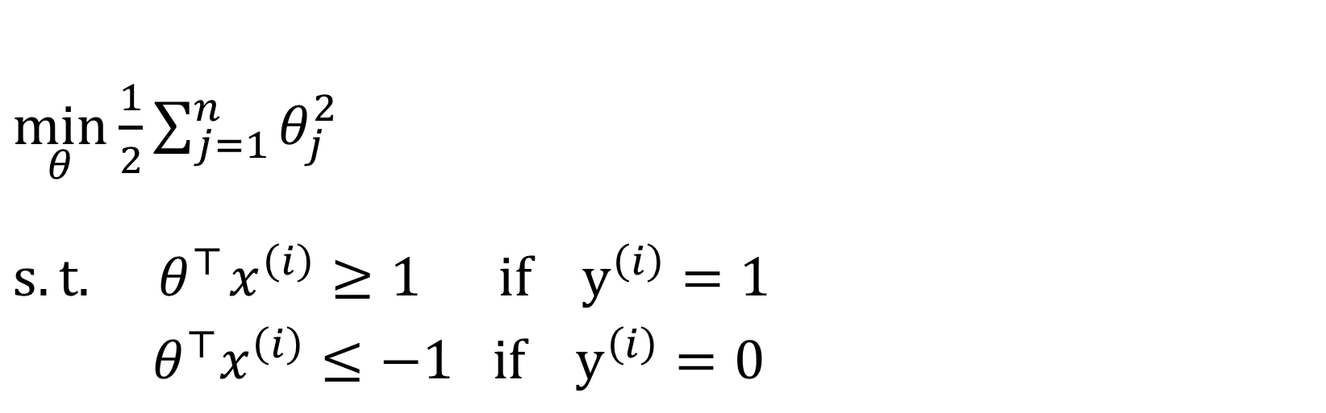
Why large margin classifiers?
$\min_{θ}$ $\frac{1}{2}\sum_{j=1}^{n}{θ_{j}^{2}}$
$$s.t.{ θ}^{⊤}x^{\left(i\right)}≥1 if y^{\left(i\right)}=1$$
$${ θ}^{⊤}x^{\left(i\right)}≤−1 if y^{\left(i\right)}=0$$
$$x_{2}$$
margin
$$x_{1}$$

Slide 8



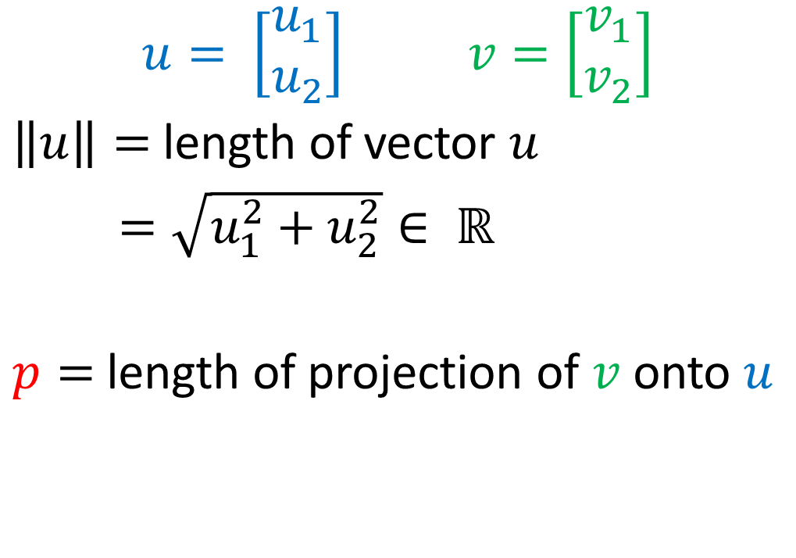



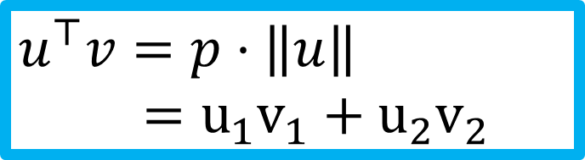
Vector inner product
$$u= \left[\begin{aligned}u_{1} \\ u_{2}\end{aligned}\right] v=\left[\begin{aligned}v_{1} \\ v_{2}\end{aligned}\right]$$
$\left\|u\right\|=$length of vector $u$
$=\sqrt{u_{1}^{2}+u_{2}^{2}}∈ ℝ$
$p=$length of projection of $v$ onto $u$
$$v$$
$v_{2}$
$$u$$
$$u_{2}$$
$v_{1}$
$$u_{1}$$
$$u^{⊤}v=p⋅\left\|u\right\|$$ $=u_{1}v_{1}+u_{2}v_{2}$

Slide 9

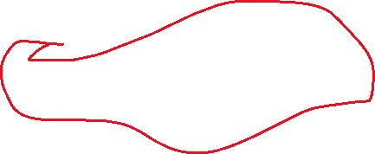
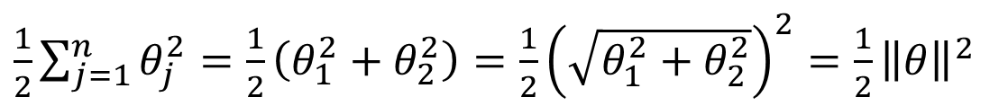

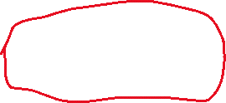
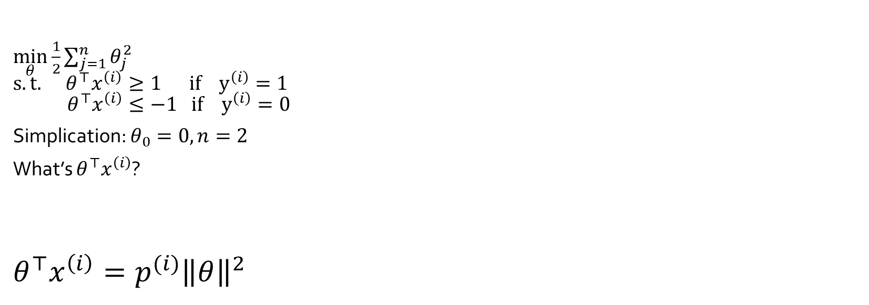
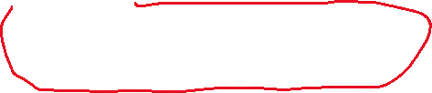





SVM decision boundary
$\frac{1}{2}\sum_{j=1}^{n}{θ_{j}^{2}}=\frac{1}{2}\left(θ_{1}^{2}+θ_{2}^{2}\right)=\frac{1}{2}{\left(\sqrt{θ_{1}^{2}+θ_{2}^{2}}\right)}^{2}=\frac{1}{2}{\left\|θ\right\|}^{2}$
$\min_{θ}$ $\frac{1}{2}\sum_{j=1}^{n}{θ_{j}^{2}}$ $$s.t.{ θ}^{⊤}x^{\left(i\right)}≥1 if y^{\left(i\right)}=1$$ $θ^{⊤}x^{\left(i\right)}≤−1 if y^{\left(i\right)}=0$
Simplication: $θ_{0}=0, n=2$
What’s $θ^{⊤}x^{\left(i\right)}$?
$$θ^{⊤}x^{\left(i\right)}=p^{(i)}{\left\|θ\right\|}^{2}$$
$$x^{(i)}$$
$x_{2}^{\left(i\right)}$
$$θ$$
$${\text{θ}}_{2}$$
$$p^{(i)}$$
$x_{1}^{\left(i\right)}$
$$θ_{1}$$

Slide 10



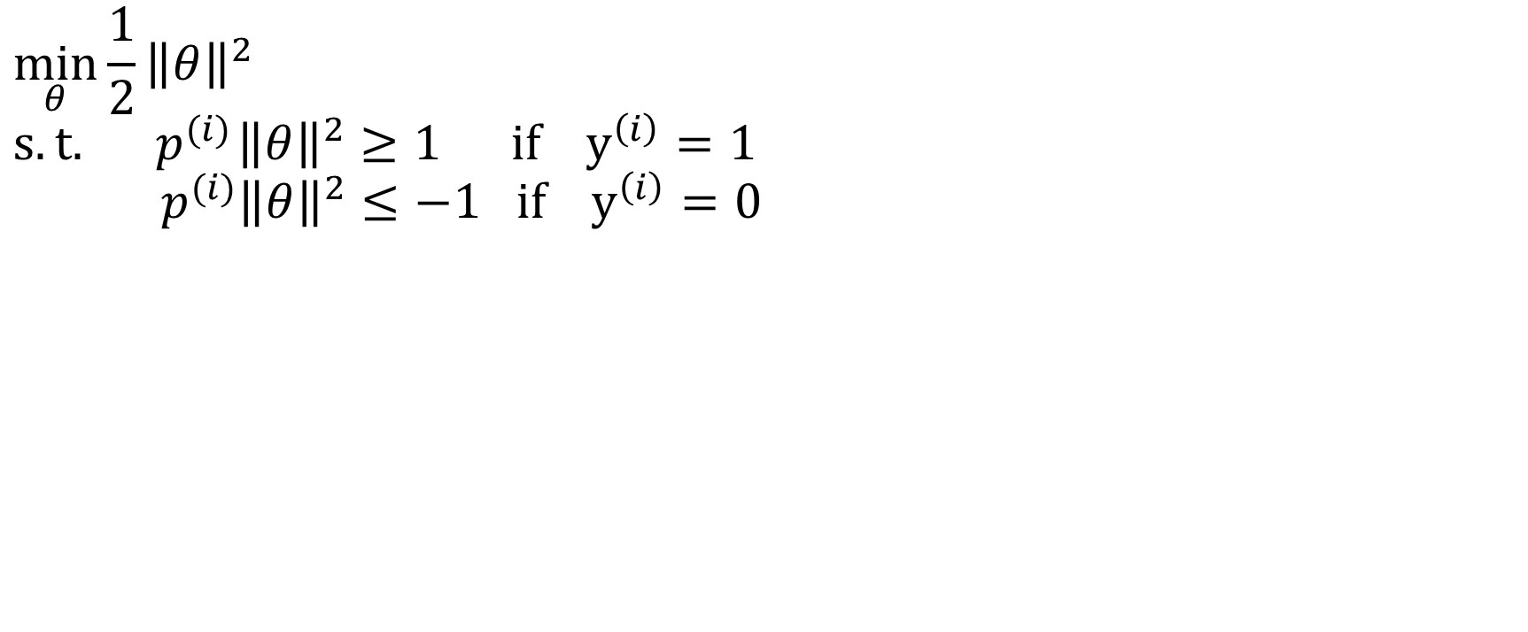



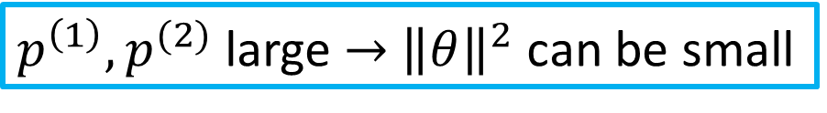
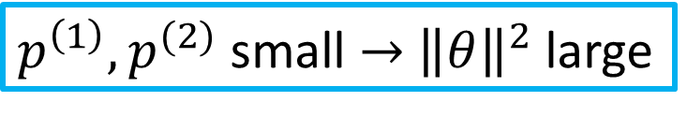
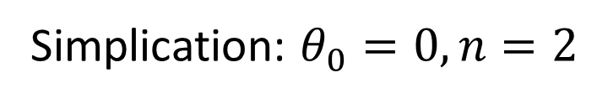
SVM decision boundary
Simplication: $θ_{0}=0, n=2$
$$\min_{θ}\frac{1}{2}{\left\|θ\right\|}^{2} \\ s.t.{ p}^{(i)}{\left\|θ\right\|}^{2}≥1 if y^{\left(i\right)}=1 \\ { p}^{(i)}{\left\|θ\right\|}^{2}≤−1 if y^{\left(i\right)}=0$$
$p^{\left(1\right)},p^{(2)}$ small $→$ ${\left\|θ\right\|}^{2}$ large
$p^{\left(1\right)},p^{(2)}$ large $→$ ${\left\|θ\right\|}^{2}$ can be small
$$θ$$
$$x^{\left(2\right)}$$
$$x^{\left(2\right)}$$
$$θ$$
$$x^{\left(1\right)}$$
$$x^{\left(1\right)}$$

Slide 11





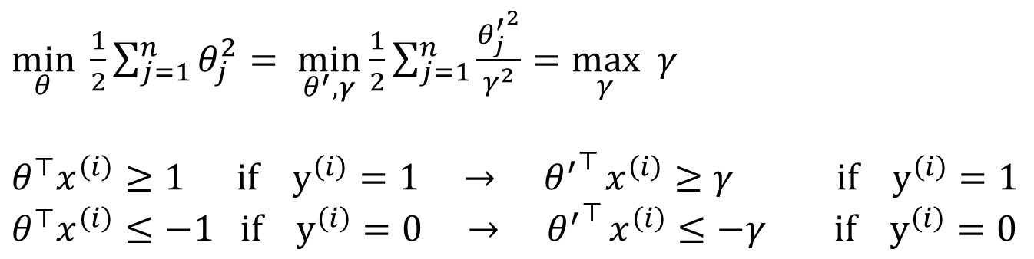
Rewrite the formulation
$$x_{2}$$
margin
$$x_{1}$$
$\min_{θ}$ $\frac{1}{2}\sum_{j=1}^{n}{θ_{j}^{2}}$
$$s.t.{ θ}^{⊤}x^{\left(i\right)}≥1 if y^{\left(i\right)}=1$$
$${ θ}^{⊤}x^{\left(i\right)}≤−1 if y^{\left(i\right)}=0$$
$\max_{θ^{′}, γ}$ $γ$
$$s.t. { \left\|θ^{′}\right\|}^{2}=1$$
$${ { θ}^{′}}^{⊤}x^{\left(i\right)}≥γ if y^{\left(i\right)}=1$$
$${ θ^{′}}^{⊤}x^{\left(i\right)}≤−γ if y^{\left(i\right)}=0$$
Let $θ_{j}=θ_{j}^{′}/γ$, with ${\left\|θ^{′}\right\|}^{2}=1$
$\min_{θ} \frac{1}{2}\sum_{j=1}^{n}{θ_{j}^{2}}= \min_{θ^{′}, γ}$ $\frac{1}{2}\sum_{j=1}^{n}{\frac{{θ_{j}^{′}}^{2}}{γ^{2}}=\max_{γ} γ}$
$$θ^{⊤}x^{\left(i\right)}≥1 if y^{\left(i\right)}=1 →{ θ^{′}}^{⊤}x^{\left(i\right)}≥γ if y^{\left(i\right)}=1$$
$$θ^{⊤}x^{\left(i\right)}≤−1 if y^{\left(i\right)}=0 →{ θ^{′}}^{⊤}x^{\left(i\right)}≤−γ if y^{\left(i\right)}=0$$

Slide 12
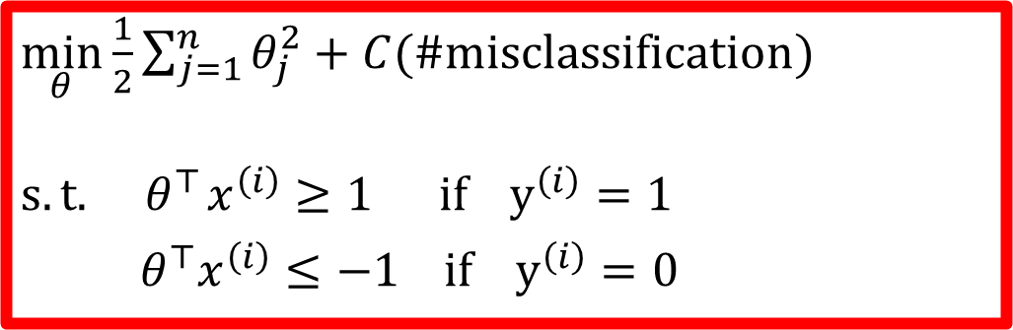



Data not linearly separable?
$\min_{θ}$ $\frac{1}{2}\sum_{j=1}^{n}{θ_{j}^{2}}$
$$s.t.{ θ}^{⊤}x^{\left(i\right)}≥1 if y^{\left(i\right)}=1$$
$${ θ}^{⊤}x^{\left(i\right)}≤−1 if y^{\left(i\right)}=0$$
$$x_{2}$$
$\min_{θ}$ $\frac{1}{2}\sum_{j=1}^{n}{θ_{j}^{2}}+C(\#misclassification)$
$$s.t.{ θ}^{⊤}x^{\left(i\right)}≥1 if y^{\left(i\right)}=1$$
$${ θ}^{⊤}x^{\left(i\right)}≤−1 if y^{\left(i\right)}=0$$
$$x_{1}$$
NP-hard ☹

Slide 13
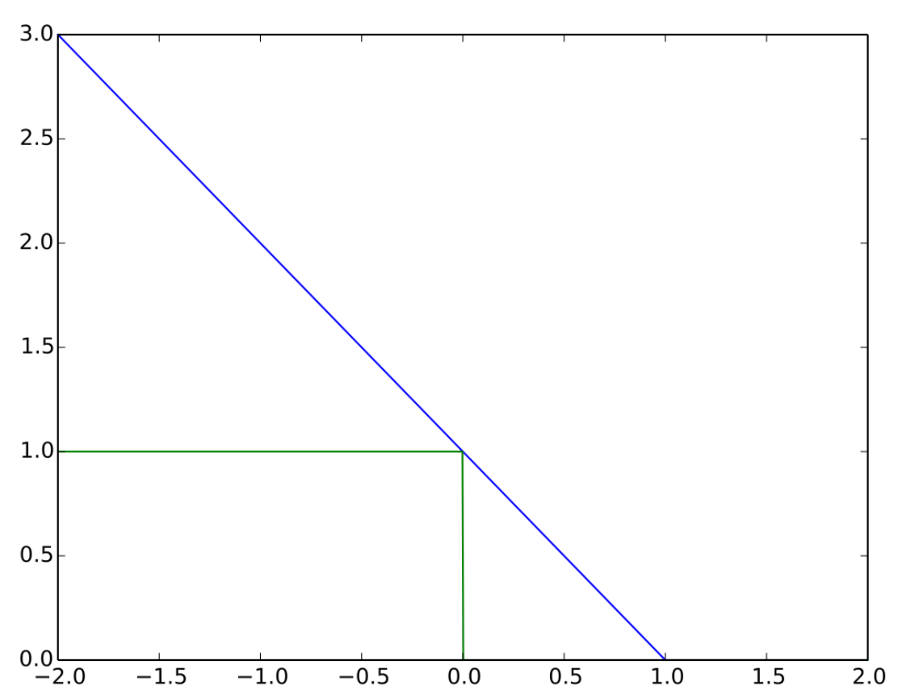
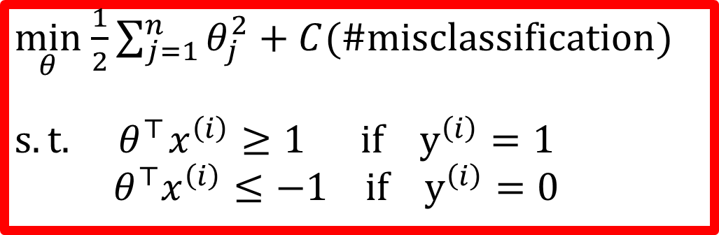
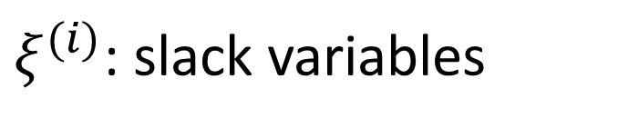
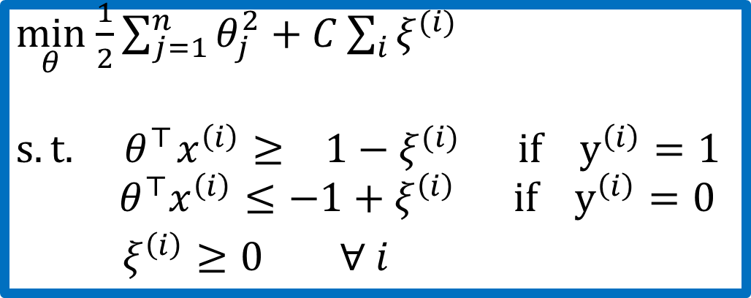

Convex relaxation
$\min_{θ}$ $\frac{1}{2}\sum_{j=1}^{n}{θ_{j}^{2}}+C(\#misclassification)$
$$s.t.{ θ}^{⊤}x^{\left(i\right)}≥1 if y^{\left(i\right)}=1$$
$${ θ}^{⊤}x^{\left(i\right)}≤−1 if y^{\left(i\right)}=0$$
NP-hard ☹
$ξ^{(i)}$: slack variables
$\min_{θ}$ $\frac{1}{2}\sum_{j=1}^{n}{θ_{j}^{2}}+C\sum_{i}{ξ^{(i)}}$
$$s.t.{ θ}^{⊤}x^{\left(i\right)}≥ 1−ξ^{(i)} if y^{\left(i\right)}=1$$
$${ θ}^{⊤}x^{\left(i\right)}≤−1+ξ^{\left(i\right)} if y^{\left(i\right)}=0$$
$ξ^{\left(i\right)}≥0 ∀ i$
$$x_{1}$$

Slide 14
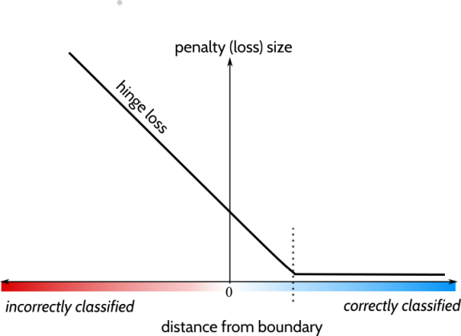
Hinge loss

Slide 15
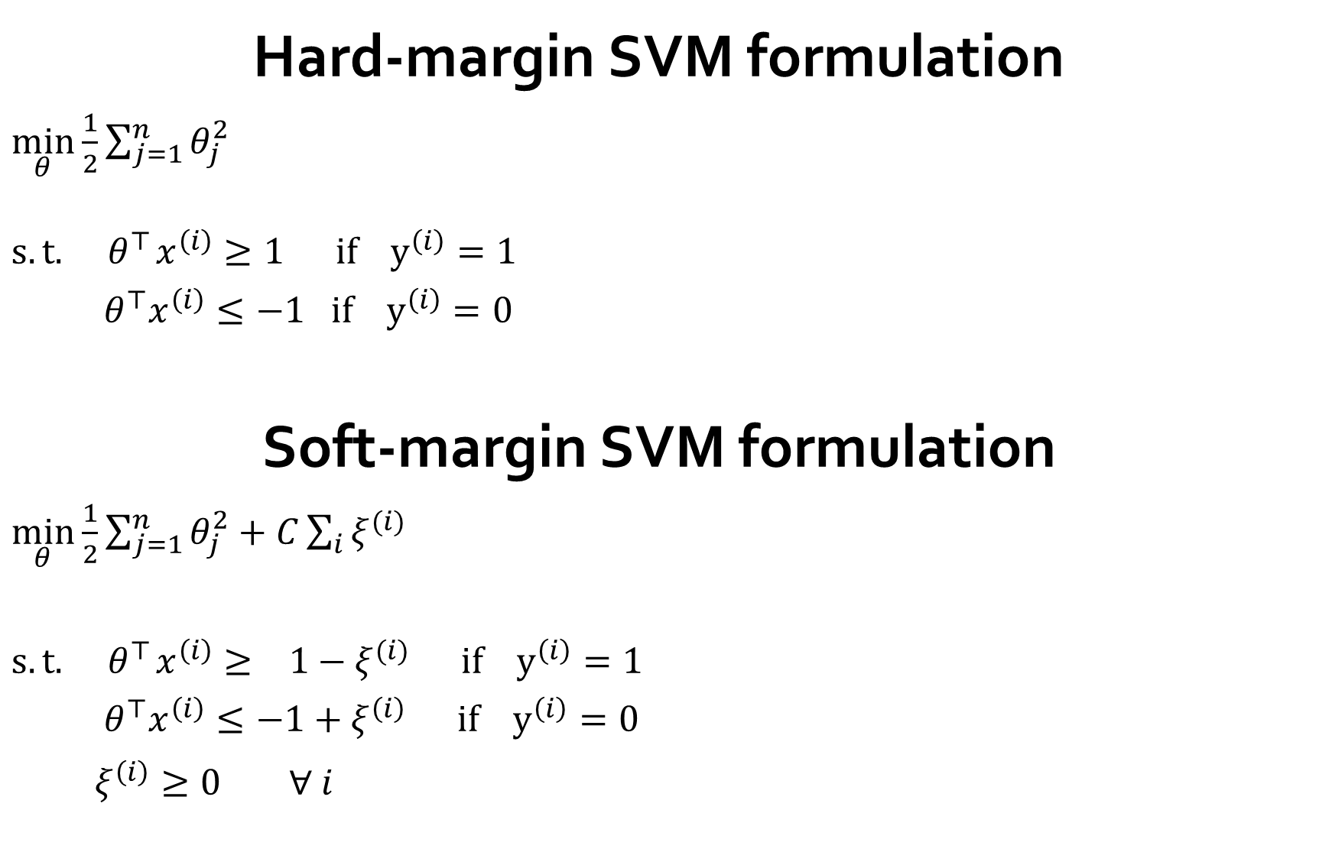


Hard-margin SVM formulation
$\min_{θ}$ $\frac{1}{2}\sum_{j=1}^{n}{θ_{j}^{2}}$
$$s.t.{ θ}^{⊤}x^{\left(i\right)}≥1 if y^{\left(i\right)}=1$$
$${ θ}^{⊤}x^{\left(i\right)}≤−1 if y^{\left(i\right)}=0$$
Soft-margin SVM formulation
$\min_{θ}$ $\frac{1}{2}\sum_{j=1}^{n}{θ_{j}^{2}}+C\sum_{i}{ξ^{(i)}}$
$$s.t.{ θ}^{⊤}x^{\left(i\right)}≥ 1−ξ^{(i)} if y^{\left(i\right)}=1$$
$${ θ}^{⊤}x^{\left(i\right)}≤−1+ξ^{\left(i\right)} if y^{\left(i\right)}=0$$
$ξ^{\left(i\right)}≥0 ∀ i$

Slide 16
Support Vector Machine
Cost function
Large margin classification
Kernels
Using an SVM

Slide 17

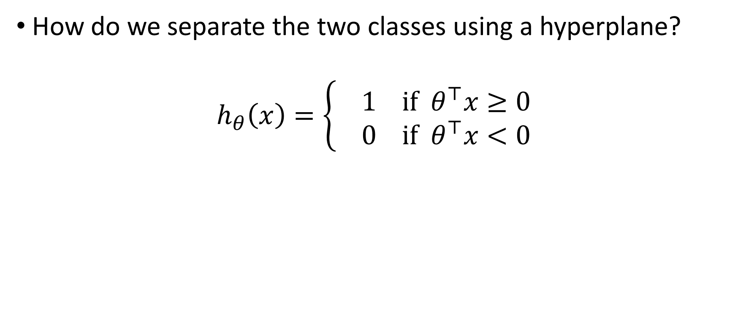
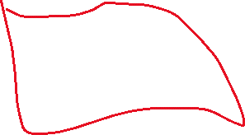
Non-linear classification
How do we separate the two classes using a hyperplane?
$$h_{θ}\left(x\right)=\left\{ \begin{aligned}1 if θ^{⊤}x≥0 \\ 0 if{ θ}^{⊤}x<0\end{aligned}\right.$$
$$x$$

Slide 18
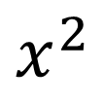
Non-linear classification
$$x^{2}$$
$$x$$

Slide 19
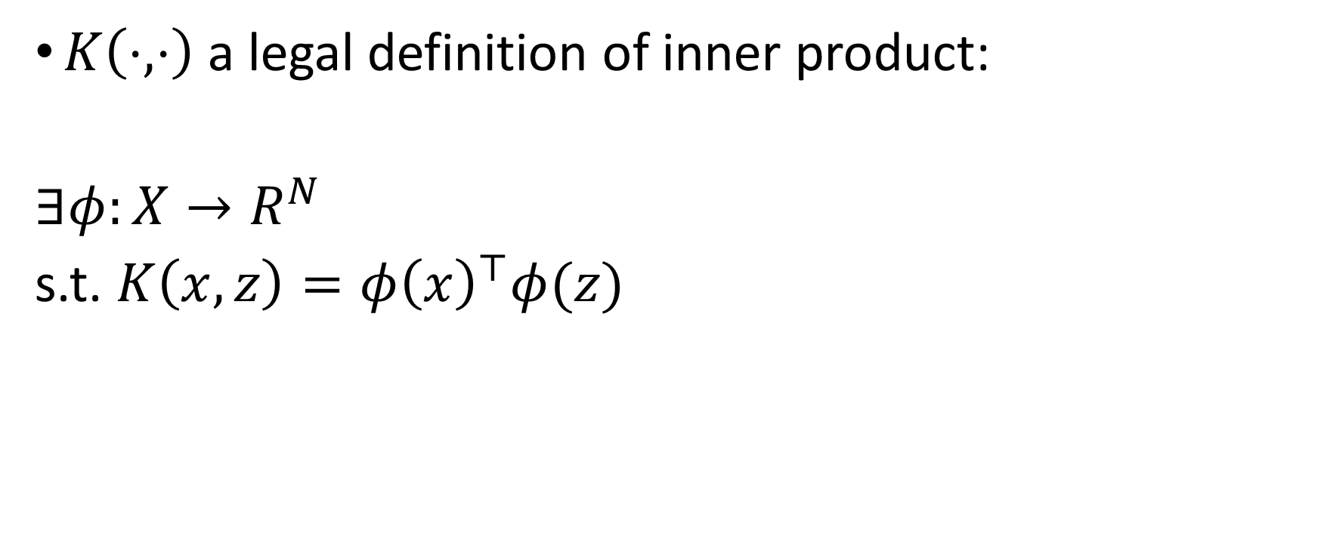
Kernel
$K\left(⋅, ⋅\right)$ a legal definition of inner product:
$∃φ:X→R^{N}$
s.t. $K\left(x,z\right)=φ{\left(x\right)}^{⊤}φ(z)$

Slide 20
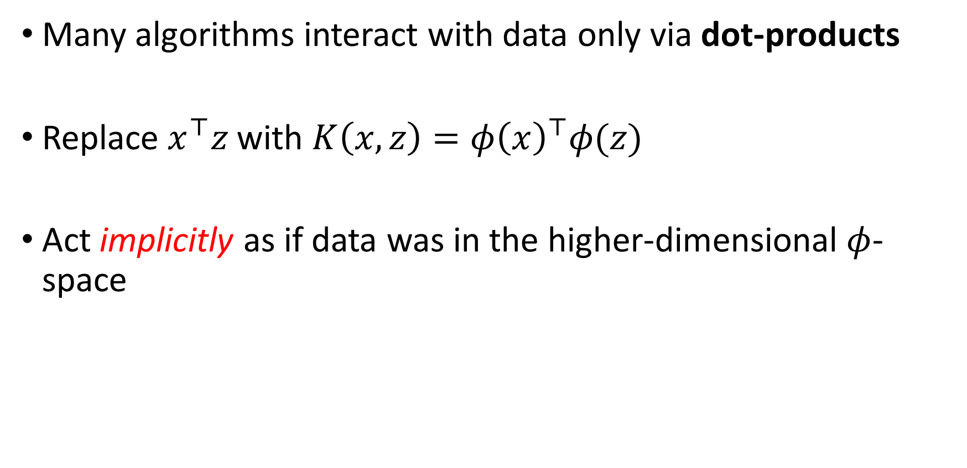
Why Kernels matter?
Many algorithms interact with data only via dot-products
Replace $x^{⊤}z$ with $K\left(x,z\right)=φ{\left(x\right)}^{⊤}φ(z)$
Act implicitly as if data was in the higher-dimensional $φ$-space

Slide 21
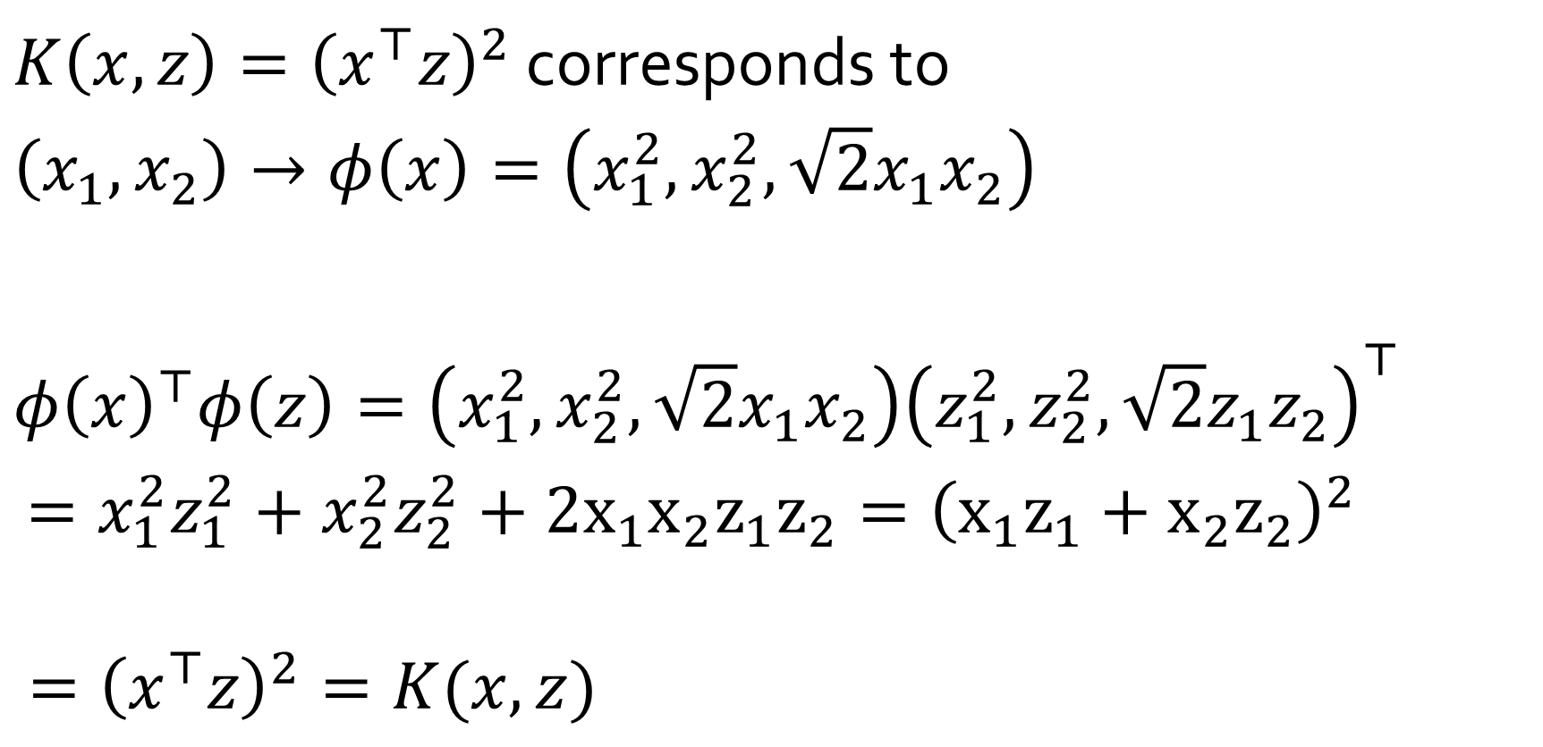
Example
$K\left(x,z\right)={\left(x^{⊤}z\right)}^{2}$ corresponds to
$$\left(x_{1}, x_{2}\right)→φ\left(x\right)=\left(x_{1}^{2}, x_{2}^{2}, \sqrt{2}x_{1}x_{2}\right)$$
$$φ{\left(x\right)}^{⊤}φ\left(z\right)=\left(x_{1}^{2}, x_{2}^{2}, \sqrt{2}x_{1}x_{2}\right){\left(z_{1}^{2}, z_{2}^{2}, \sqrt{2}z_{1}z_{2}\right)}^{⊤}$$ $=x_{1}^{2}z_{1}^{2}+x_{2}^{2}z_{2}^{2}+2x_{1}x_{2}z_{1}z_{2}={\left(x_{1}z_{1}+x_{2}z_{2}\right)}^{2}$
$$={\left(x^{⊤}z\right)}^{2}=K(x,z)$$

Slide 22
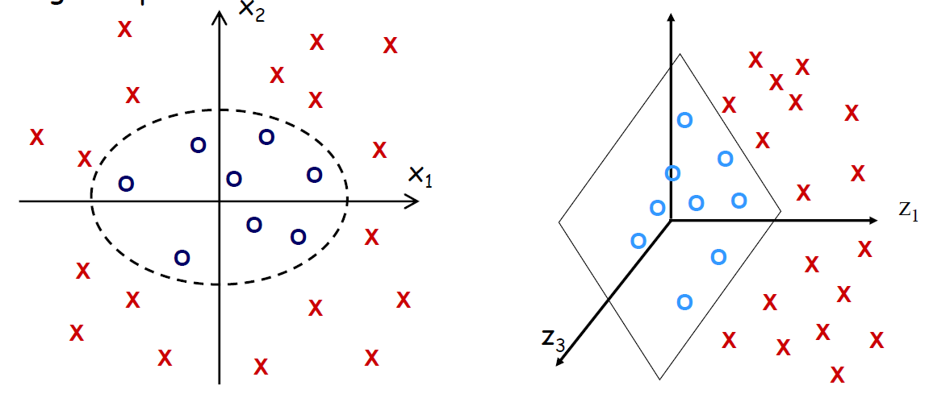
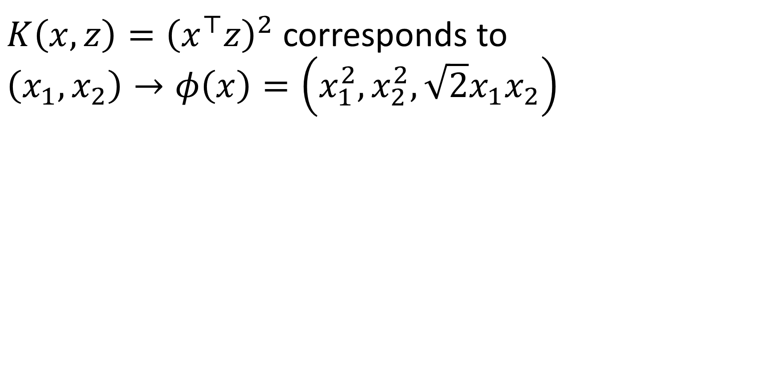
Example
$K\left(x,z\right)={\left(x^{⊤}z\right)}^{2}$ corresponds to
$$\left(x_{1}, x_{2}\right)→φ\left(x\right)=\left(x_{1}^{2}, x_{2}^{2}, \sqrt{2}x_{1}x_{2}\right)$$

Slide 23
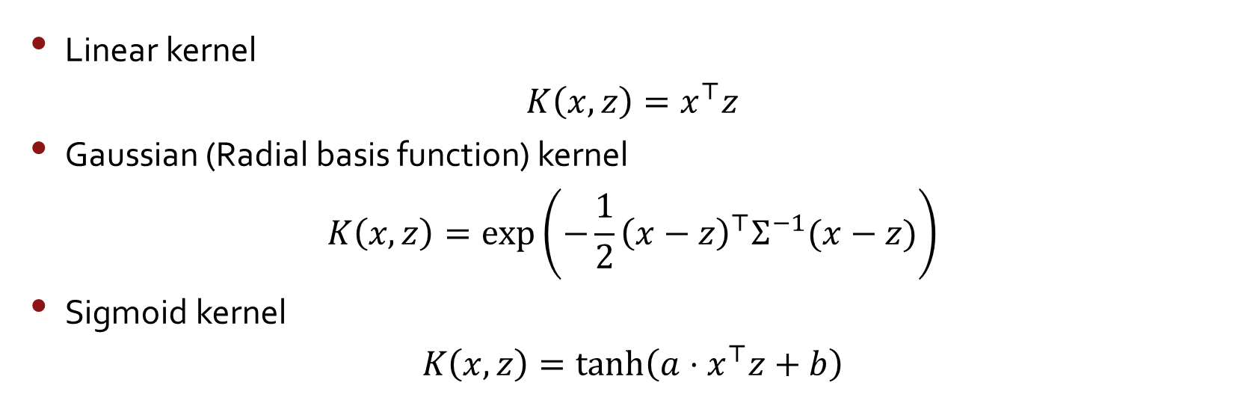


Example kernels
Linear kernel
$$K\left(x,z\right)=x^{⊤}z$$
Gaussian (Radial basis function) kernel
$$K\left(x,z\right)=\exp\left(−\frac{1}{2}{\left(x−z\right)}^{⊤}Σ^{−1}(x−z)\right)$$
Sigmoid kernel
$$K\left(x,z\right)=\tanh\left(a⋅x^{⊤}z+b\right)$$

Slide 24
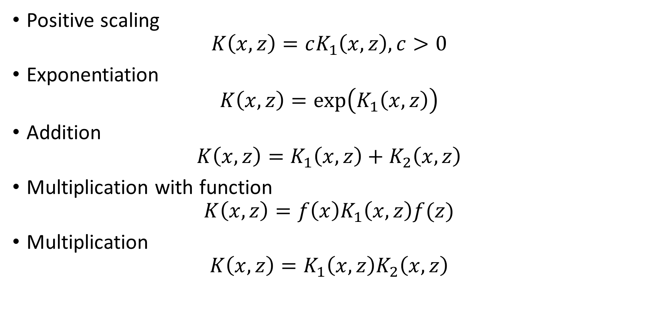
Constructing new kernels
Positive scaling
$$K\left(x,z\right)=cK_{1}\left(x,z\right), c>0$$
Exponentiation
$$K\left(x,z\right)=\exp\left(K_{1}\left(x,z\right)\right)$$
Addition
$$K\left(x,z\right)=K_{1}\left(x,z\right)+K_{2}\left(x,z\right)$$
Multiplication with function
$$K\left(x,z\right)=f\left(x\right)K_{1}\left(x,z\right)f(z)$$
Multiplication
$$K\left(x,z\right)=K_{1}\left(x,z\right)K_{2}\left(x,z\right)$$

Slide 25



Non-linear decision boundary
$$x_{2}$$
Predict $y=1 if$
$θ_{0}+θ_{1}x_{1}+θ_{2}x_{2}+θ_{3}x_{1}x_{2}$
$+ θ_{4}x_{1}^{2}+θ_{5}x_{2}^{2}+⋯≥0$
$$θ_{0}+θ_{1}f_{1}+θ_{2}f_{2}+θ_{3}f_{3}+⋯$$
$$f_{1}=x_{1}, f_{2}=x_{2}, f_{3}=x_{1}x_{2}, ⋯$$
Is there a different/better choice of the features $f_{1},f_{2},f_{3}, ⋯$?
$$x_{1}$$

Slide 26
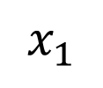

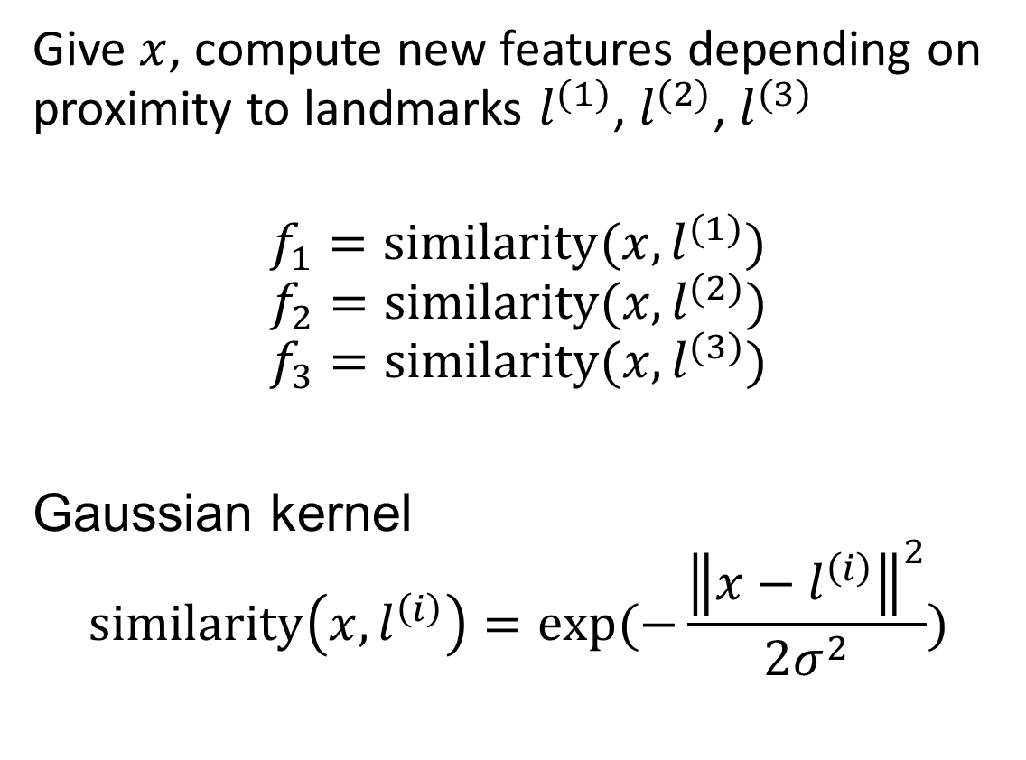


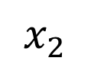
Kernel
$$x_{2}$$
Give $x$, compute new features depending on proximity to landmarks $l^{(1)}$, $l^{(2)}$, $l^{(3)}$
$$f_{1}=similarity(x, l^{(1)})$$
$$f_{2}=similarity(x, l^{(2)})$$
$$f_{3}=similarity(x, l^{(3)})$$
Gaussian kernel
$$similarity\left(x, l^{\left(i\right)}\right)=exp⁡(−\frac{{\left\|x−l^{\left(i\right)}\right\|}^{2}}{2σ^{2}})$$
$$l^{(1)}$$
$$l^{(2)}$$
$$l^{(3)}$$
$$x_{1}$$

Slide 27
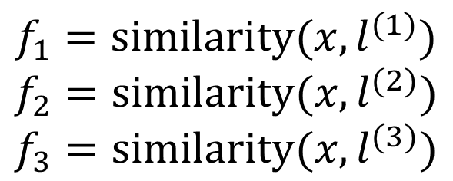
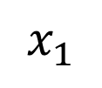




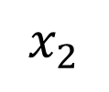
$$x_{2}$$
$$l^{(1)}$$
$$l^{(2)}$$
Predict $y=1 if$
$$θ_{0}+θ_{1}f_{1}+θ_{2}f_{2}+θ_{3}f_{3}≥0$$
Ex: $θ_{0}=−0.5, θ_{1}=1, θ_{2}=1, θ_{3}=0$
$$l^{(3)}$$
$$x_{1}$$
$$f_{1}=similarity(x, l^{(1)})$$
$$f_{2}=similarity(x, l^{(2)})$$
$$f_{3}=similarity(x, l^{(3)})$$

Slide 28

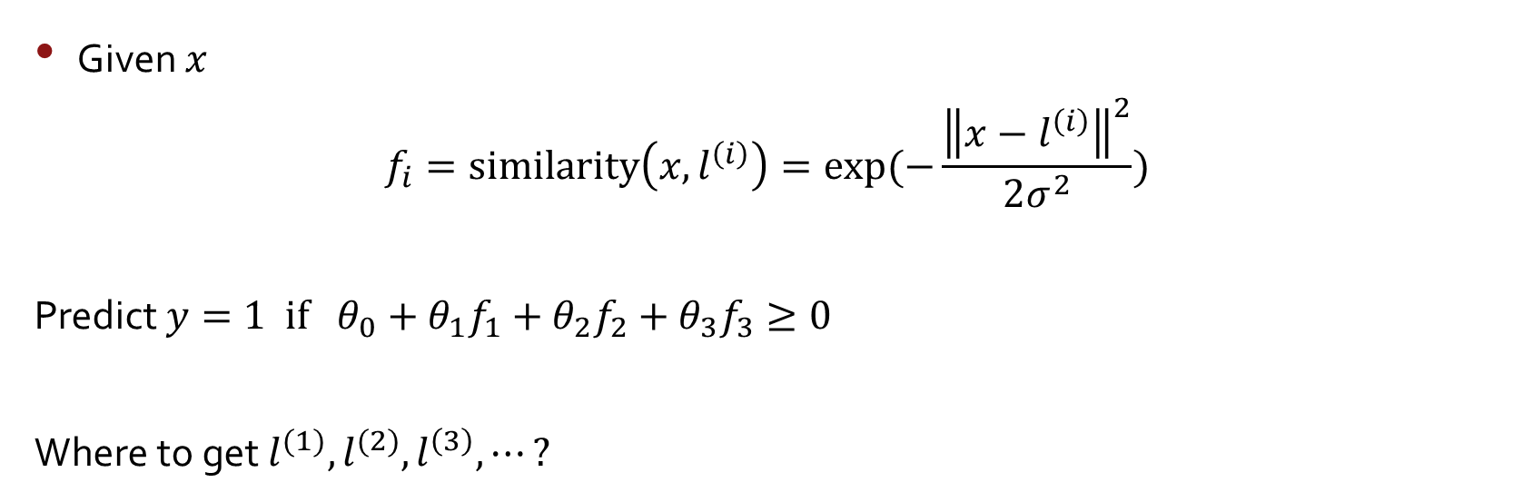


Choosing the landmarks
Given $x$
$$f_{i}=similarity\left(x,l^{\left(i\right)}\right)=exp⁡(−\frac{{\left\|x−l^{\left(i\right)}\right\|}^{2}}{2σ^{2}})$$
Predict $y=1 if θ_{0}+θ_{1}f_{1}+θ_{2}f_{2}+θ_{3}f_{3}≥0$
Where to get $l^{(1)},l^{(2)},l^{\left(3\right)}, ⋯?$
$$l^{\left(1\right)}$$
$$l^{\left(2\right)}$$
$$l^{\left(3\right)}$$
$$⋮$$
$$l^{\left(m\right)}$$
$$x_{2}$$
$$x_{1}$$

Slide 29


SVM with kernels
Given $\left(x^{\left(1\right)},y^{\left(1\right)}\right), \left(x^{\left(2\right)},y^{\left(2\right)}\right), ⋯,\left(x^{\left(m\right)},y^{\left(m\right)}\right)$
Choose ${l^{\left(1\right)}=x}^{\left(1\right)},{l^{\left(2\right)}=x}^{\left(2\right)}$, ${l^{\left(3\right)}=x}^{\left(3\right)}, ⋯$, ${l^{\left(m\right)}=x}^{\left(m\right)}$
Given example $x$:
$f_{1}=similarity\left(x, l^{(1)}\right)$
$f_{2}=similarity\left(x, l^{(2)}\right)$
$⋯$
For training example $\left(x^{\left(i\right)},y^{\left(i\right)}\right)$:
$x^{\left(i\right)}→f^{(i)}$
$$f=\left[\begin{aligned}f_{0} \\ f_{1} \\ f_{2} \\ ⋮ \\ f_{m}\end{aligned}\right]$$

Slide 30

SVM with kernels
Hypothesis: Given $x$, compute features $f∈ℝ^{m+1}$
Predict $y=1 if θ^{⊤}f≥0$
Training (original)
$$\min_{θ} C\left[\sum_{i=1}^{m}{y^{(i)} cost_{1}\left(θ^{⊤}x^{\left(i\right)}\right)+(1−y^{\left(i\right)}\text{)} cost_{0}\left(θ^{⊤}x^{\left(i\right)}\right)}\right]+\frac{1}{2}\sum_{j=1}^{n}{θ_{j}^{2}}$$
Training (with kernel)
$$\min_{θ} C\left[\sum_{i=1}^{m}{y^{(i)} cost_{1}\left(θ^{⊤}f^{\left(i\right)}\right)+(1−y^{\left(i\right)}\text{)} cost_{0}\left(θ^{⊤}f^{\left(i\right)}\right)}\right]+\frac{1}{2}\sum_{j=1}^{m}{θ_{j}^{2}}$$

Slide 31


Support vector machines (Primal/Dual)
Primal form
Lagrangian dual form
$\min_{θ,ξ^{(i)}}$ $\frac{1}{2}\sum_{j=1}^{n}{θ_{j}^{2}}+C\sum_{i}{ξ^{(i)}}$
$$s.t.{ θ}^{⊤}x^{\left(i\right)}≥ 1−ξ^{(i)} if y^{\left(i\right)}=1$$
$${ θ}^{⊤}x^{\left(i\right)}≤−1+ξ^{\left(i\right)} if y^{\left(i\right)}=0$$
$ξ^{\left(i\right)}≥0 ∀ i$
$$\min_{α}\frac{1}{2}\sum_{i}{\sum_{j}{y^{(i)}y^{(j)}α^{(i)}α^{(j)}{x^{\left(i\right)}}^{⊤}x^{(j)}−\sum_{i}{α^{(i)}}}}$$
$$s.t. 0≤α^{(i)}≤C_{i} \\ \sum_{i}{y^{(i)}α^{(i)}=0}$$

Slide 32


SVM (Lagrangian dual)
$$\min_{α}\frac{1}{2}\sum_{i}{\sum_{j}{y^{(i)}y^{(j)}α^{(i)}α^{(j)}{x^{\left(i\right)}}^{⊤}x^{(j)}−\sum_{i}{α^{(i)}}}}$$
$$s.t. 0≤α^{(i)}≤C_{i} \\ \sum_{i}{y^{(i)}α^{(i)}=0}$$
Classifier: $θ=\sum_{i}{α^{(i)}}y^{\left(i\right)}x^{(i)}$
The points $x^{(i)}$ for which $α^{(i)}≠0→$ Support Vectors
Replace ${x^{\left(i\right)}}^{⊤}x^{(j)}$with $K(x^{\left(i\right)}, x^{(j)})$

Slide 33

SVM parameters
$C\left(=\frac{1}{λ}\right)$ Large $C$: Lower bias, high variance. Small $C:$ Higher bias, low variance.
$σ^{2}$
Large $σ^{2}:$ features $f_{i}$ vary more smoothly.
Higher bias, lower variance
Small $σ^{2}:$ features $f_{i}$ vary less smoothly.
Lower bias, higher variance

Slide 34

SVM Demo
https://cs.stanford.edu/people/karpathy/svmjs/demo/

Slide 35
Support Vector Machine
Cost function
Large margin classification
Kernels
Using an SVM

Slide 36

Using SVM
SVM software package (e.g., liblinear, libsvm) to solve for $θ$
Need to specify:
Choice of parameter $C$.
Choice of kernel (similarity function):
Linear kernel: Predict $y=1 if θ^{⊤}x≥0$
Gaussian kernel:
$f_{i}=exp⁡(−\frac{{\left\|x−l^{\left(i\right)}\right\|}^{2}}{2σ^{2}})$, where $l^{(i)}=x^{(i)}$
Need to choose $σ^{2}$. Need proper feature scaling

Slide 37
Kernel (similarity) functions
Note: not all similarity functions make valid kernels.
Many off-the-shelf kernels available:
Polynomial kernel
String kernel
Chi-square kernel
Histogram intersection kernel

Slide 38



Multi-class classification
$$x_{2}$$
$$x_{1}$$
Use one-vs.-all method. Train $K$ SVMs, one to distinguish $y=i$ from the rest, get $θ^{\left(1\right)}, θ^{(2)}, ⋯,θ^{(K)}$
Pick class$i$ with the largest ${θ^{\left(i\right)}}^{⊤}x$

Slide 39
Multi-class classification
Multiclass SVM :
Multiclass SVM aims to assign labels to instances by using support vector machines, where the labels are drawn from a finite set of several elements.
The dominant approach for doing so is to reduce the single multiclass problem into multiple binary classification problems. Common methods for such reduction include:

Slide 40
Multi-class classification
The following are examples of multiclass classification:
Classifying a text as positive, negative, or neutral
Determining the dog breed in an image
Categorizing a news article to sports, politics, economics, or social

Slide 41
Multi-class classification
One-vs-Rest and One-vs-One
One-vs-rest (OvR for short, also referred to as One-vs-All or OvA) is a heuristic method for using binary classification algorithms for multi-class classification.
It involves splitting the multi-class dataset into multiple binary classification problems.
A binary classifier is then trained on each binary classification problem and predictions are made using the model that is the most confident.

Slide 42

Multi-class classification

Slide 43
Multi-class classification
Training an One-vs-Rest classifier for our model actually involves creating three binary classifiers under the hood:
OvR binary classifier 1: yellow vs {blue, red}
OvR binary classifier 2: blue vs {yellow, red}
OvR binary classifier 3: red vs {blue, yellow}

Slide 44

Multi-class classification

Slide 45
Multi-class classification
The One-vs-One method can be used as well for creating a multiclass SVM classifier. Given the assembly line scenario from above, we create a set of binary classifiers, each representing one of the pairs:
OvO binary classifier 1: yellow vs blue
OvO binary classifier 2: yellow vs red
OvO binary classifier 3: blue vs red

Slide 46

Multi-class classification

Slide 47
Multi-class classification
One-Vs-One for Multi-Class Classification
One-vs-One (OvO for short) is another heuristic method for using binary classification algorithms for multi-class classification.
Like one-vs-rest, one-vs-one splits a multi-class classification dataset into binary classification problems. Unlike one-vs-rest that splits it into one binary dataset for each class, the one-vs-one approach splits the dataset into one dataset for each class versus every other class.

Slide 48

Logistic regression vs. SVMs
$n=$number of features ($x∈ℝ^{n+1})$, $m=$ number of training examples
If $n$ is large (relative to $m$): $(n=10,000, m=10−1000)$ $→$Use logistic regression or SVM without a kernel (“linear kernel”)
If $n$ is small, $m$ is intermediate: $(n=1−1000, m=10−10,000)$ $→$ Use SVM with Gaussian kernel
If $n$ is small, $m$ is large: $(n=1−1000, m=50,000+)$ $→$ Create/add more features, then use logistic regression of linear SVM
Neural network likely to work well for most of these case, but slower to train

Slide 49

Things to remember
Cost function
$$\min_{θ} C\left[\sum_{i=1}^{m}{y^{(i)} cost_{1}\left(θ^{⊤}f^{\left(i\right)}\right)+(1−y^{\left(i\right)}\text{)} cost_{0}\left(θ^{⊤}f^{\left(i\right)}\right)}\right]+\frac{1}{2}\sum_{j=1}^{m}{θ_{j}^{2}}$$
Large margin classification
Kernels
Using an SVM
$$x_{2}$$
margin
$$x_{1}$$

